Slide 1
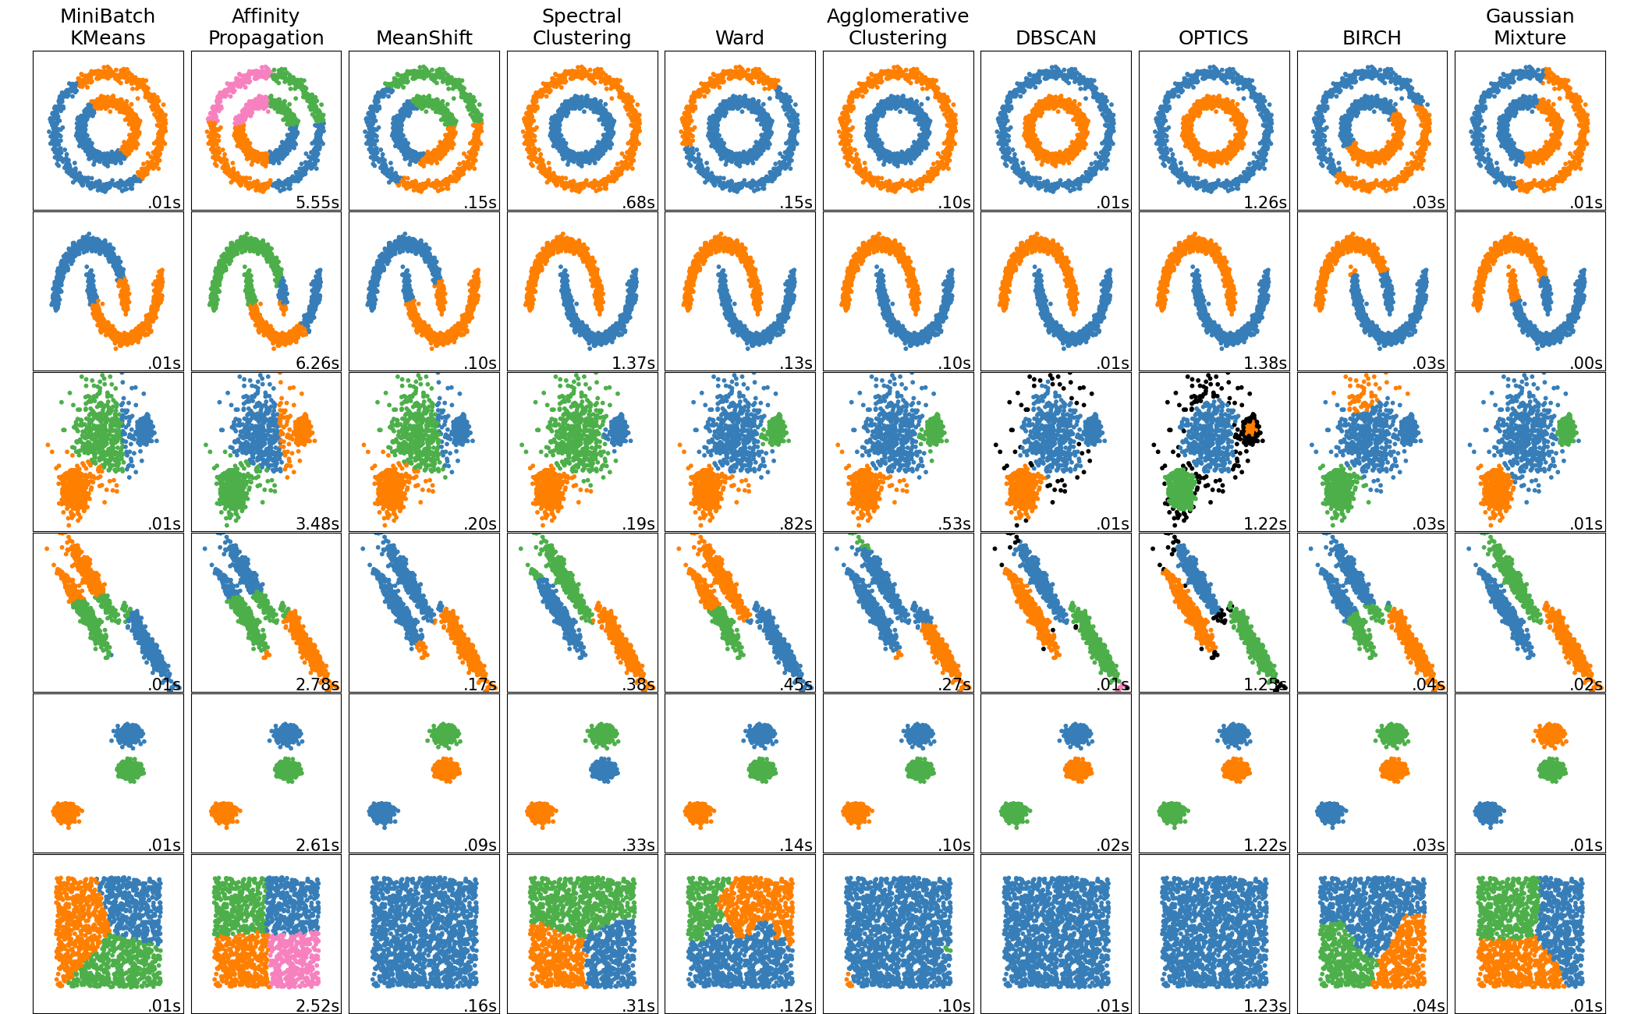
Cluster Analysis

Slide 2
What is Cluster Analysis?
Cluster: A collection of data objects
similar (or related) to one another within the same group
dissimilar (or unrelated) to the objects in other groups
Cluster analysis (or clustering, data segmentation, …)
Finding similarities between data according to the characteristics found in the data and grouping similar data objects into clusters
Unsupervised learning: no predefined classes (i.e., learning by observations vs. learning by examples: supervised)
Typical applications
As a stand-alone tool to get insight into data distribution
As a preprocessing step for other algorithms

Slide 3
Clustering as a Preprocessing Tool (Utility)
Summarization:
Preprocessing for regression, PCA, classification, and association analysis
Compression:
Image processing: vector quantization
Finding K-nearest Neighbors
Localizing search to one or a small number of clusters
Outlier detection
Outliers are often viewed as those “far away” from any cluster

Slide 4
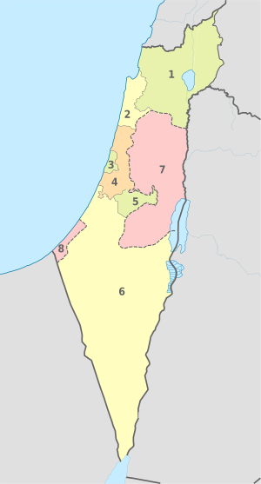
Clustering for Data Understanding and Applications
Information retrieval: document clustering
Land use: Identification of areas of similar land use in an earth observation database
Marketing: Help marketers discover distinct groups in their customer bases, and then use this knowledge to develop targeted marketing programs
City-planning: Identifying groups of houses according to their house type, value, and geographical location
Earth-quake studies: Observed earth quake epicenters should be clustered along continent faults
Climate: understanding earth climate, find patterns of atmospheric and ocean.

Slide 5
Requirements and Challenges
Scalability
Clustering all the data instead of only on samples
Ability to deal with different types of attributes
Numerical, binary, categorical, ordinal, linked, and mixture of these
Constraint-based clustering
User may give inputs on constraints
Use domain knowledge to determine input parameters
Interpretability and usability
Others
Discovery of clusters with arbitrary shape
Ability to deal with noisy data
Incremental clustering and insensitivity to input order
High dimensionality

Slide 6

Types of Data in General and also in Clustering Analysis

Slide 7
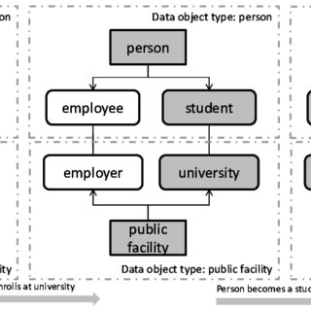
Data Objects
Datasets are made up of data objects.
A data object represents an entity
in a sales database, the objects may be customers, store items, and sales;
in a medical database, the objects may be patients;
in a university database, the objects may be students, professors, and courses.
Data objects are typically described by attributes.
Data objects can also be referred to as samples, examples, instances, data points, or objects.
If the data objects are stored in a database, they are data tuples. That is, the rows of a database correspond to the data objects, and the columns correspond to the attributes.

Slide 8
Attributes
An attribute is a data field, representing a characteristic or feature of a data object.
The nouns attribute, dimension, feature, and variable are often used interchangeably in the
literature.
The term dimension is commonly used in data warehousing.
Machine learning literature tends to use the term feature, while statisticians prefer the term variable.
Attributes describing a customer object can include, for example, customer ID, name, and address.
A set of attributes used to describe a given object is called an attribute vector (or feature vector).

Slide 9
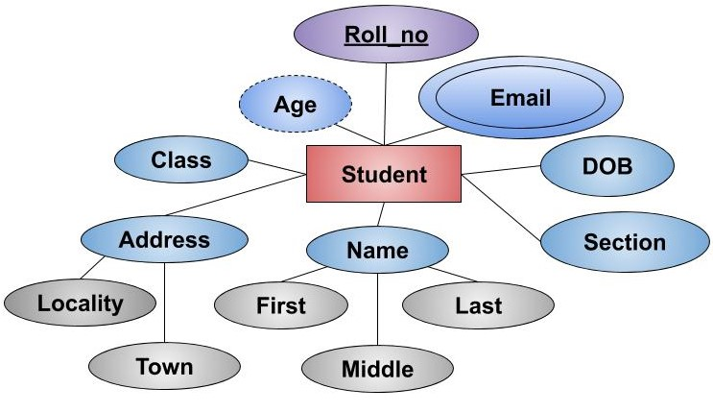
Attribute Types
The type of an attribute is determined by the set of possible values:
nominal,
binary,
ordinal, or
numeric

Slide 10
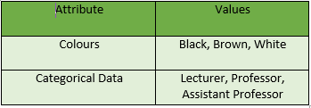
Nominal Attributes
Nominal means “relating to names.”
The values of a nominal attribute are symbols or names of things.
Each value represents some kind of category, code, or state, and so on.
Nominal attributes are also referred to as categorical.
The values do not have any meaningful order.
In computer science, the values are also known as enumerations.

Slide 11
Nominal Attributes
Examples:
Hair_color= {auburn, black, blond, brown, grey, red, white}
Occupation = {teacher, dentist, programmer, farmer, …}
marital status, occupation, ID numbers, zip codes.

Slide 12
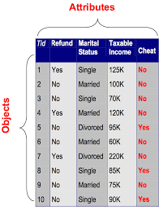
Binary Attributes
A binary attribute is a nominal attribute with only two categories or states: 0 or 1, where 0 typically means that the attribute is absent, and 1 means that it is present.
Binary attributes are referred to as Boolean if the two states correspond to true and false.
Notes:
Because nominal attribute values do not have any meaningful order about them and are not quantitative, it makes no sense to find the mean (average) value or median (middle) value for such an attribute, given a set of objects.

Slide 13


Binary Attributes
For example:
{Non-smoker: 0, Smoker: 1}
{negative test result: 0, positive test result: 1}
Notes:
Because nominal attribute values do not have any meaningful order about them and are not quantitative, it makes no sense to find the mean (average) value or median (middle) value for such an attribute, given a set of objects.

Slide 14

Binary Attributes
A binary attribute is symmetric if both of its states are equally valuable and carry the same weight; that is, there is no preference on which outcome should be coded as 0 or 1.
One such example could be the attribute gender having the states male and female.
A binary attribute is asymmetric if the outcomes of the states are not equally important, such as the positive and negative outcomes of a medical test for HIV.
By convention, we code the most important outcome, which is usually the rarest one, by 1 (e.g., HIV positive) and the other by 0 (e.g., HIV negative).
Notes:
Because nominal attribute values do not have any meaningful order about them and are not quantitative, it makes no sense to find the mean (average) value or median (middle) value for such an attribute, given a set of objects.

Slide 15
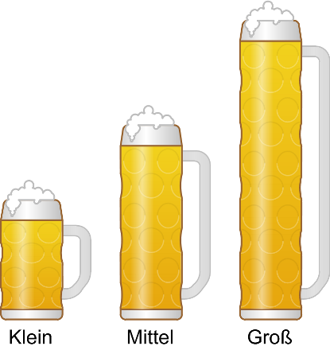
Ordinal Attributes
An ordinal attribute is an attribute with possible values that have a meaningful order or ranking among them, but the magnitude between successive values is not known.
Suppose that drink size corresponds to the size of drinks available at a fast-food restaurant.
This nominal attribute has three possible values:
small, medium, and large.
The values have a meaningful sequence (which corresponds to increasing drink size); however, we cannot tell from the values how much bigger, say, a medium is than a large.
Notes:
Because nominal attribute values do not have any meaningful order about them and are not quantitative, it makes no sense to find the mean (average) value or median (middle) value for such an attribute, given a set of objects.

Slide 16
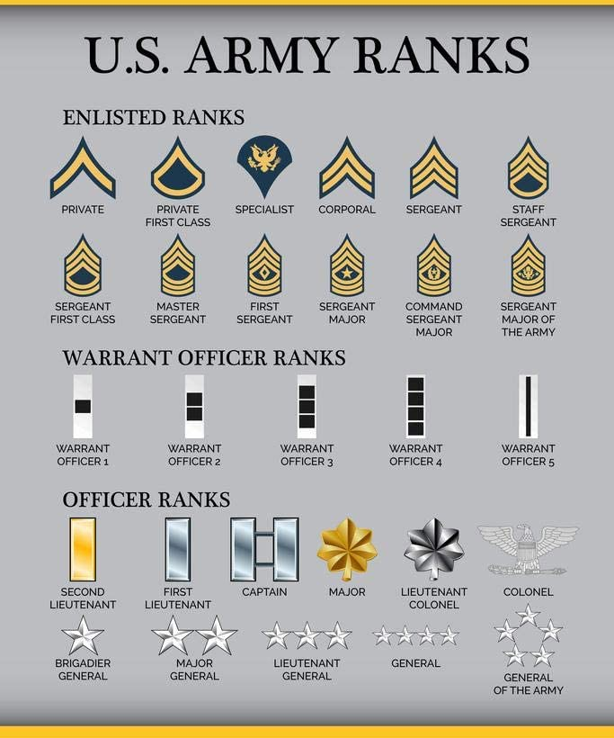

Ordinal Attributes
Professional ranks can be enumerated in a sequential order: for example, assistant, associate, and full for professors, and private, private first class, specialist, corporal, and sergeant for army ranks.
Notes:
Other examples of ordinal attributes include grade (e.g., A+, A, A-, B+, and so on) and professional rank.

Slide 17
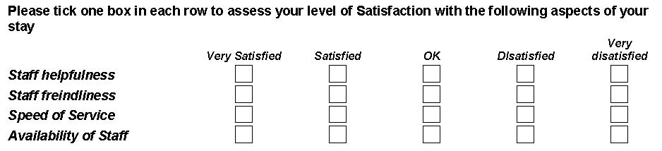
Ordinal Attributes
Ordinal attributes are useful for registering subjective assessments of qualities that cannot be measured objectively; thus ordinal attributes are often used in surveys for ratings.
In one survey, participants were asked to rate how satisfied they were as customers.
Customer satisfaction had the following ordinal categories: 0: very dissatisfied, 1: somewhat dissatisfied, 2: neutral, 3: satisfied, and 4: very satisfied
Notes:
Other examples of ordinal attributes include grade (e.g., A+, A, A-, B+, and so on) and professional rank.

Slide 18
Nominal, Binary, and Ordinal Attributes
Note that nominal, binary, and ordinal attributes are qualitative.
That is, they describe a feature of an object without giving an actual size or quantity.
The values of such qualitative attributes are typically words representing categories.
If integers are used, they represent computer codes for the categories, as opposed to measurable quantities (e.g., 0 for small drink size, 1 for medium, and 2 for large).
Notes:
Other examples of ordinal attributes include grade (e.g., A+, A, A-, B+, and so on) and professional rank.

Slide 19
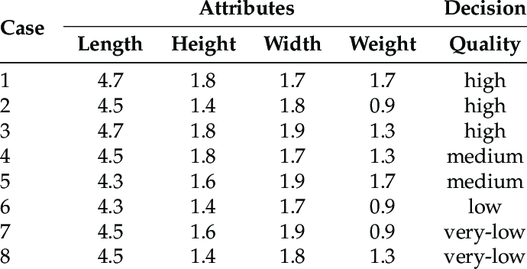
Numeric Attributes
A numeric attribute is quantitative; that is, it is a measurable quantity, represented in integer or real values.
Numeric attributes can be interval-scaled or ratio-scaled.
Notes:
Other examples of ordinal attributes include grade (e.g., A+, A, A-, B+, and so on) and professional rank.

Slide 20

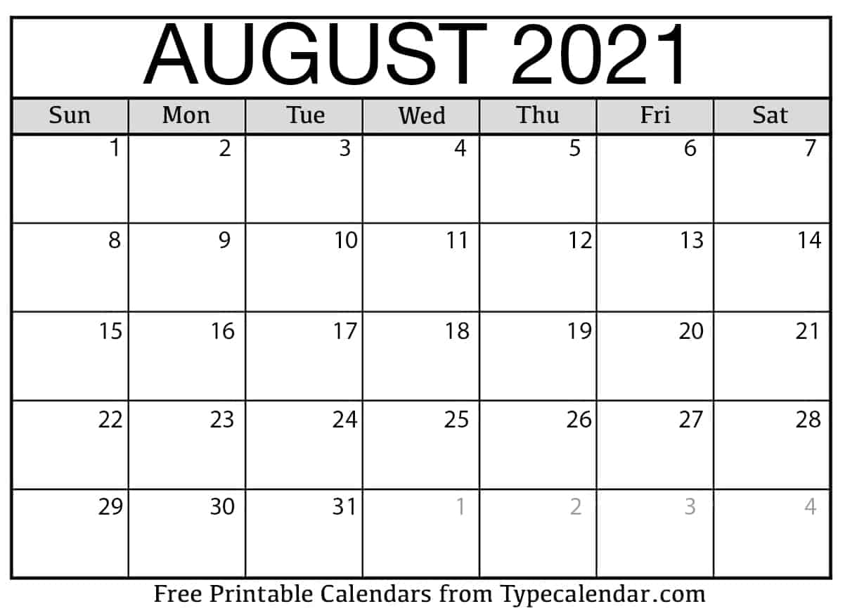
Interval-Scaled Attributes
Interval-scaled attributes are measured on a scale of equal-size units. The values of interval-scaled attributes have order and can be positive, 0, or negative.
Thus, in addition to providing a ranking of values, such attributes allow us to compare and quantify the difference between values.
For example
a temperature of 20C is five degrees higher than a temperature of 15C.
In calendar dates: the years 2002 and 2010 are eight years apart.
Notes:
Other examples of ordinal attributes include grade (e.g., A+, A, A-, B+, and so on) and professional rank.

Slide 21
Ratio-Scaled Attributes
A ratio-scaled attribute is a numeric attribute with an inherent zero-point. That is, if a measurement is ratio-scaled, we can speak of a value as being a multiple (or ratio) of another value.
In addition, the values are ordered, and we can also compute the difference between values, as well as the mean, median, and mode.
For example:
Unlike temperatures in Celsius and Fahrenheit, the Kelvin (K) temperature scale has what is considered a true zero-point (0K =-273.15C): It is the point at which the particles that comprise matter have zero kinetic energy.
Count attributes, such as years of experience for employees
number of words in a document
weight, height, latitude and longitude.
coordinates (e.g., when clustering houses),
monetary quantities (e.g., you are 100 times richer with $100 than with $1).
Notes:
Other examples of ordinal attributes include grade (e.g., A+, A, A-, B+, and so on) and professional rank.

Slide 22
Attributes
Nominal: categories, states, or “names of things”
Hair_color= {auburn, black, blond, brown, grey, red, white}
marital status, occupation, ID numbers, zip codes
Binary
Nominal attribute with only 2 states (0 and 1)
Symmetric binary: both outcomes equally important (e.g., gender)
Asymmetric binary: outcomes not equally important
medical test: positive vs. negative,
True/False
Convention: assign 1 to most important outcome (e.g., HIV positive)
Ordinal
Values have a meaningful order (ranking) but magnitude between successive values is not known.
Size = {small, medium, large}, grades, army rankings

Slide 23
Discrete Vs. Continuous Attributes
A discrete attribute has a finite or countably infinite set of values, which may or may not be represented as integers.
The attributes hair color, smoker, medical test, and drink size each have a finite number of values, and so are discrete.
Note that discrete attributes may have numeric values, such as 0 and 1 for binary attributes or, the values 0 to 110 for the attribute age.
If an attribute is not discrete, it is continuous.
The terms numeric attribute and continuous attribute are often used interchangeably in the literature.
Continuous attributes are typically represented as floating-point variables.
For example, a person's height could be any value (within the range of human heights), not just certain fixed heights, time in a race you could even measure it to fractions of a second, a dog's weight, or length of a leaf.
Notes:
Other examples of ordinal attributes include grade (e.g., A+, A, A-, B+, and so on) and professional rank.

Slide 24
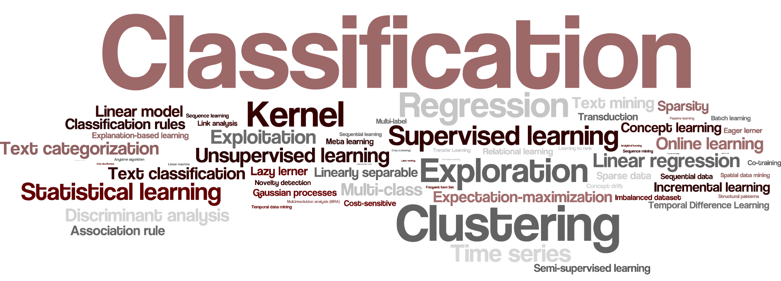
Difference Between Classification and Clustering

Slide 25

Classification
Classification is a form of data analysis that extracts models describing important data classes.
Such models, called classifiers, predict categorical (discrete, unordered) class labels.
For example, we can build a classification model to categorize bank loan applications as either “safe” or “risky”.

Slide 26

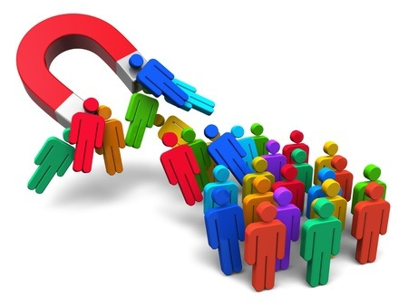

Classification
Classification has numerous applications, including fraud detection, target marketing, performance prediction, manufacturing, and medical diagnosis.

Slide 27
Four Tiers Model
Applications
…
Fraud Detection
Demand Planning
Tasks
…
…
Classification
Regression
Clustering
Models
…
Machine Learning
Decision Trees
Artificial Neural Networks
Partitioning
Algorithms
C4.5
CART
Back propagation
K-Means

Slide 28

Classification - Definition
A bank loans officer needs analysis of her data to learn which loan applicants are “safe” and which are “risky” for the bank.
A marketing manager needs data analysis to help guess whether a customer with a given profile will buy a new computer.
A medical researcher wants to analyze breast cancer data to predict which one of three specific treatments a patient should receive.

Slide 29
Classification - Definition
In each of these examples, the data analysis task is classification, where a model or classifier is constructed to predict class (categorical) labels, such as “safe” or “risky” for the loan application data; “yes” or “no” for the marketing data; or “treatment A,” “treatment B,” or “treatment C” for the medical data.
These categories can be represented by discrete values, where the ordering among values has no meaning.
For example, the values 1, 2, and 3 may be used to represent treatments A, B, and C, where there is no ordering implied among this group of treatment regimes.

Slide 30
Regression - Definition
Suppose that the marketing manager wants to predict how much a given customer will spend during a sale.
This data analysis task is an example of numeric prediction, where the model constructed predicts a continuous-valued function, or ordered value, as opposed to a class label.
This model is a predictor.
Regression analysis is a statistical methodology that is most often used for numeric prediction; hence the two terms tend to be used synonymously, although other methods for numeric prediction exist.
Classification and numeric prediction are the two major types of prediction problems.

Slide 31
Examples of typical classification / prediction tasks
Typical classification tasks
Credit approval: approve / deny
Target marketing: will buy / will not buy
Medical diagnosis: Hepatitis B / Hepatitis C
Fraud detection: lawful transaction / fraudulent transaction
Typical prediction / regression tasks
Weather forecast: predict tomorrow’s temperature
Stock trading: predict stock’s price tomorrow

Slide 32
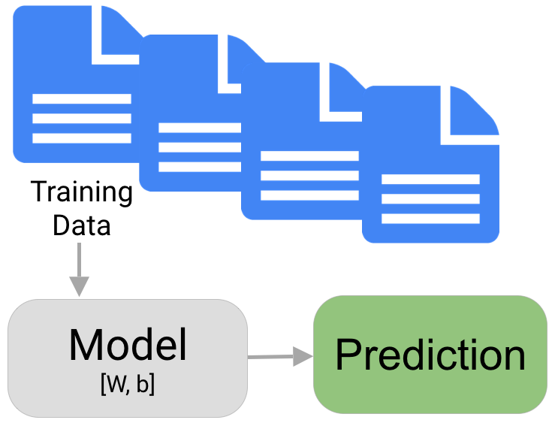
Data Classification
Data classification is a two-step process, consisting of:
a learning step (where a classification model is constructed)
a classification step (where the model is used to predict class labels for given data).

Slide 33
Learning Step
A classifier is built describing a predetermined set of data classes or concepts.
This is the learning step (or training phase), where a classification algorithm builds the classifier by analyzing or “learning from” a training set made up of database tuples and their associated class labels.

Slide 34
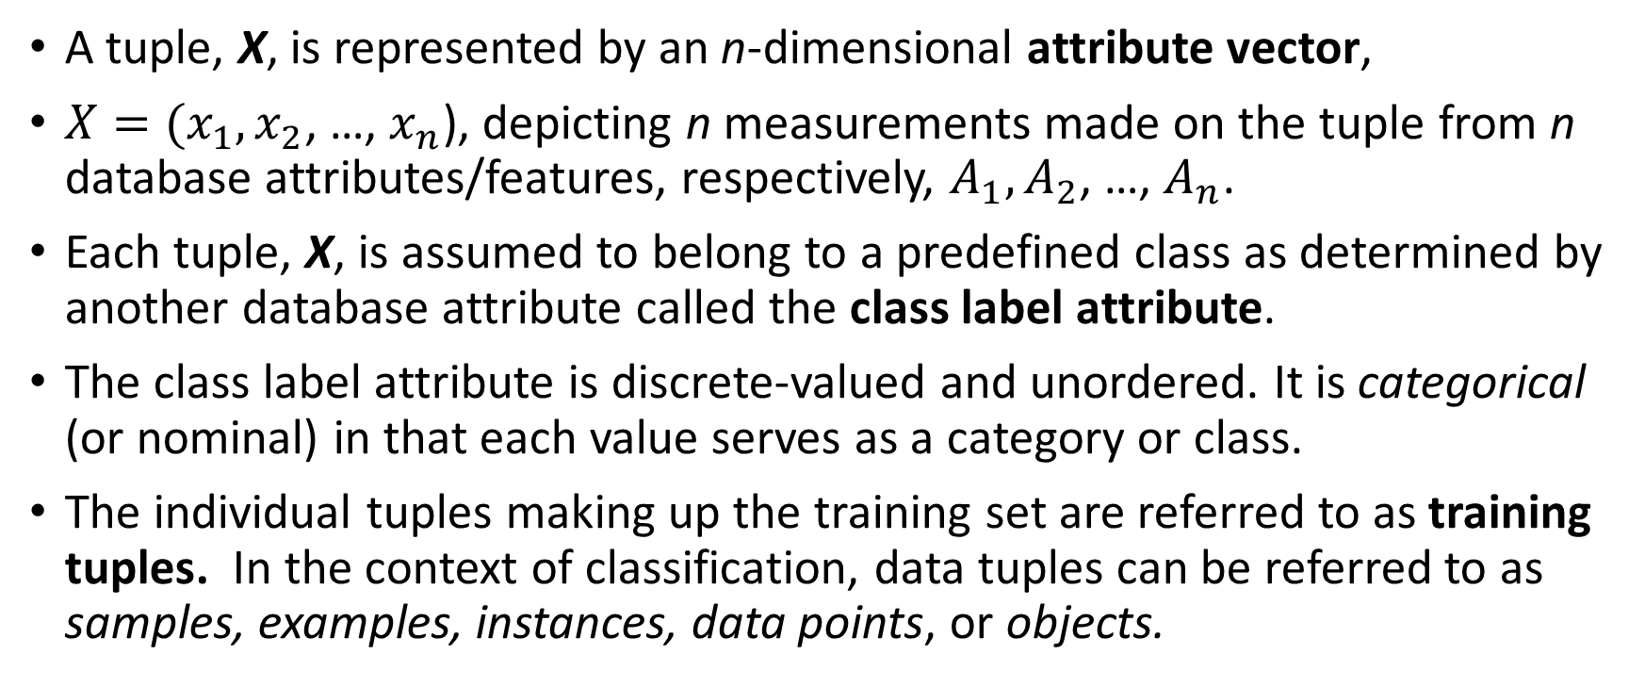
Learning Step
A tuple, X, is represented by an n-dimensional attribute vector,
$X=(x_{1},x_{2}$, …, $x_{n}$), depicting n measurements made on the tuple from n database attributes/features, respectively, $A_{1},A_{2}$, …, $A_{n}$.
Each tuple, X, is assumed to belong to a predefined class as determined by another database attribute called the class label attribute.
The class label attribute is discrete-valued and unordered. It is categorical (or nominal) in that each value serves as a category or class.
The individual tuples making up the training set are referred to as training tuples. In the context of classification, data tuples can be referred to as samples, examples, instances, data points, or objects.

Slide 35
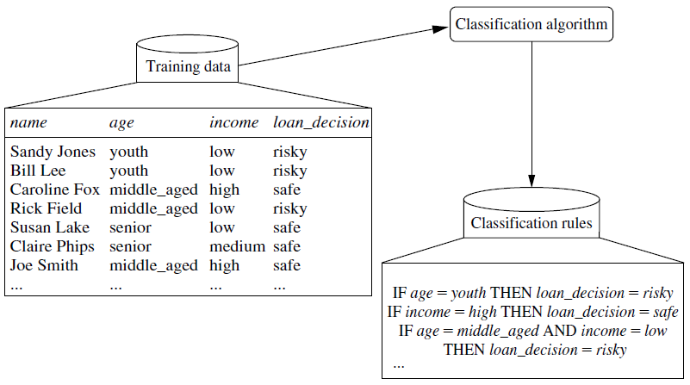
Learning Step

Slide 36
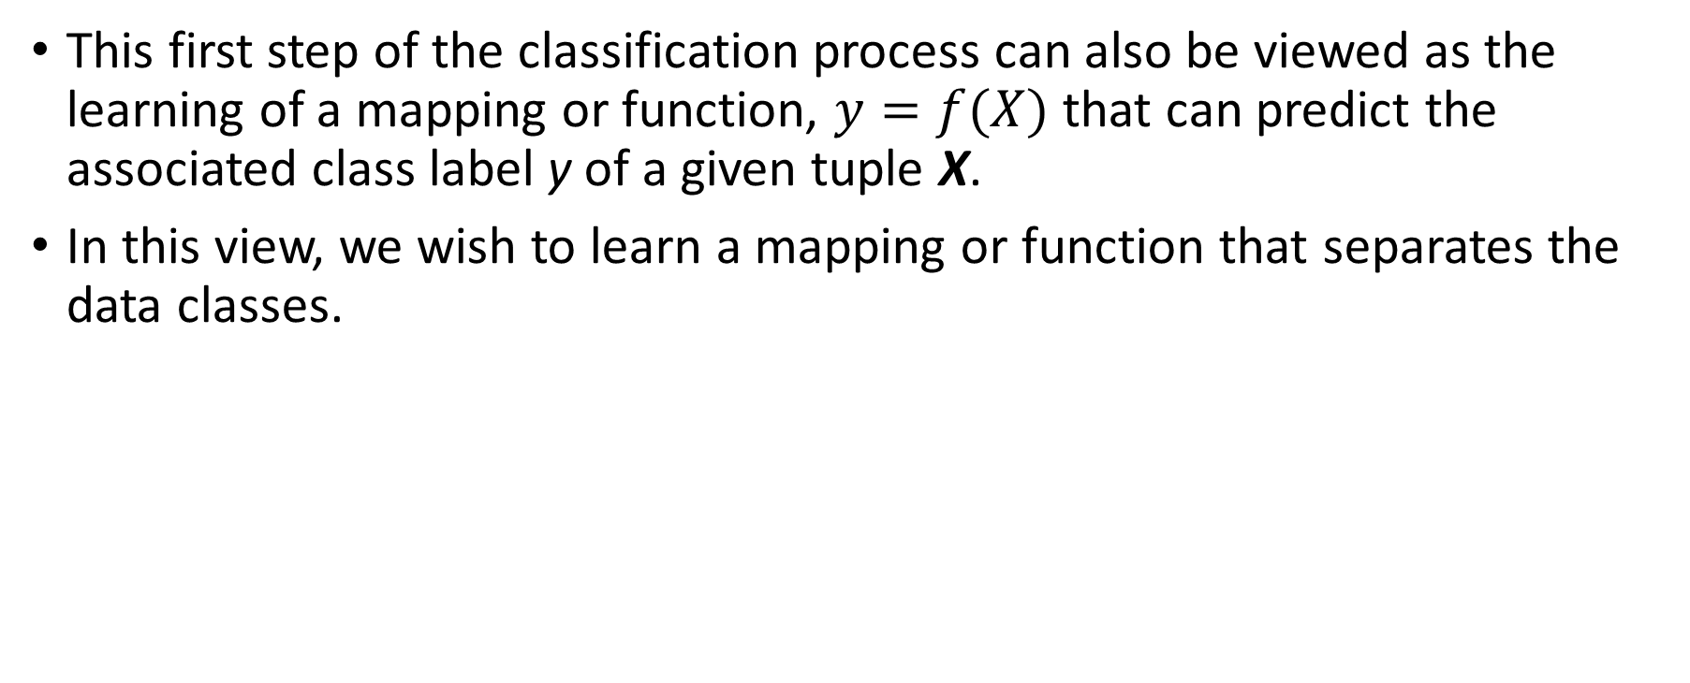
The Classification Process
This first step of the classification process can also be viewed as the learning of a mapping or function, $y=f(X)$ that can predict the associated class label y of a given tuple X.
In this view, we wish to learn a mapping or function that separates the data classes.

Slide 37

Supervised Learning
Because the class label of each training tuple is provided, this step is also known as supervised learning (i.e., the learning of the classifier is “supervised” in that it is told to which class each training tuple belongs).

Slide 38
Unsupervised Learning
It contrasts with unsupervised learning (or clustering), in which the class label of each training tuple is not known, and the number or set of classes to be learned may not be known in advance.
For example, if we did not have the loan decision data available for the training set, we could use clustering to try to determine “groups of like tuples,” which may correspond to risk groups within the loan application data.

Slide 39
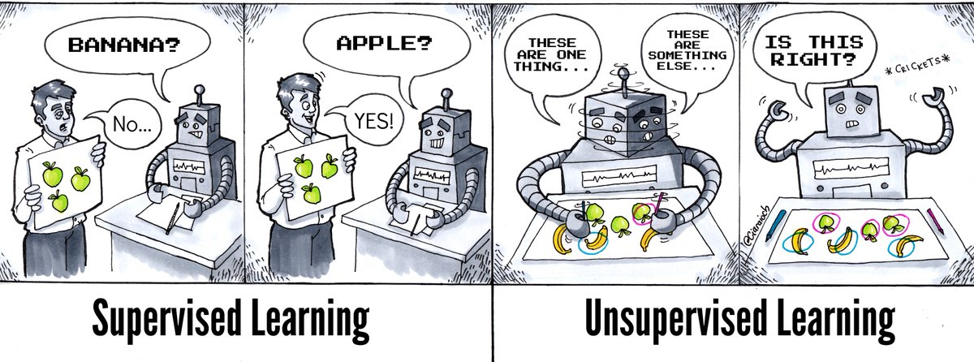
Unsupervised Learning
It contrasts with unsupervised learning (or clustering), in which the class label of each training tuple is not known, and the number or set of classes to be learned may not be known in advance.
For example, if we did not have the loan decision data available for the training set, we could use clustering to try to determine “groups of like tuples,” which may correspond to risk groups within the loan application data.

Slide 40
Supervised Learning
Classification
Binary Classification Tasks (Concept learning)
One Class Classification – only instances from one label are given
Multi-Class Classification
Multi-Label Classification
Regression

Slide 41

Binary classification
Binary classification is the task of classifying the elements of a set into two groups on the basis of a classification rule.
Typical binary classification problems include:
Medical testing to determine if a patient has certain disease or not;
Quality control in industry, deciding whether a specification has been met;
In information retrieval, deciding whether a page should be in the result set of a search or not.

Slide 42

One Class classification
One-class classification (OCC), also known as unary classification or class-modelling, tries to identify objects of a specific class amongst all objects, by primarily learning from a training set containing only the objects of that class.
This is different from and more difficult than traditional classification problem, which tries to distinguish between two or more classes with the training set containing objects from all the classes.
Examples include the monitoring of helicopter gearboxes, motor failure prediction, or the operational status of a nuclear plant as 'normal': In this scenario, there are few, if any, examples of catastrophic system states; only the statistics of normal operation are known.

Slide 43
Multi Class classification
Multi class or multi nomial classification is the problem of classifying instances into one of three or more classes.
While many classification algorithms naturally permit the use of more than two classes, some are by nature binary algorithms; these can, however, be turned into multi nomial classifiers by a variety of strategies.
Multi class classification should not be confused with multi-label classification, where multiple labels are to be predicted for each instance.

Slide 44
Supervised Learning - Multi Class
Email Length
New Recipients

Slide 45
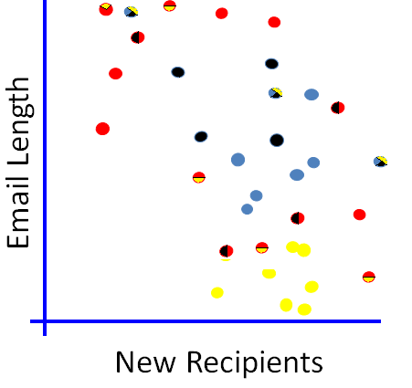
Supervised Learning - Multi Label
Multi-label learning refers to the classification problem where each example can be assigned to multiple class labels simultaneously

Slide 46
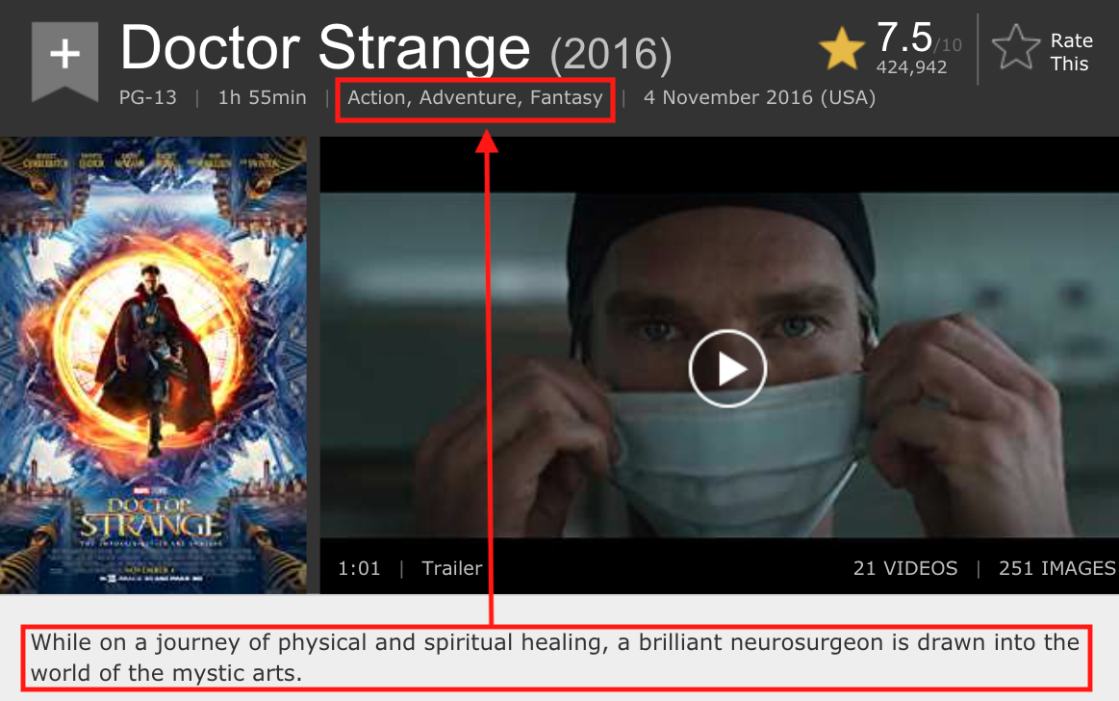
Supervised Learning - Multi Label
Multi-label learning refers to the classification problem where each example can be assigned to multiple class labels simultaneously
Notes:
Example

Slide 47
Supervised Learning - Regression
Find a relationship between a numeric dependent variable and one or more independent variables
Email Length
New Recipients

Slide 48

Classification Vs. Regression

Slide 49

Classification Vs. Regression
Notes:
Classification is the task of predicting a discrete class label.
Regression is the task of predicting a continuous quantity.

Slide 50
Beyond Supervised Learning
Unsupervised
There is no existing class concept
Semi-supervised classification
make use of labeled and unlabeled data
Reinforcement Learning
Learner can run directly in the environment without any human guidance and obtain feedback.

Slide 51
Unsupervised Learning
It contrasts with unsupervised learning (or clustering), in which the class label of each training tuple is not known, and the number or set of classes to be learned may not be known in advance.
For example, if we did not have the loan decision data available for the training set, we could use clustering to try to determine “groups of like tuples,” which may correspond to risk groups within the loan application data.

Slide 52
Unsupervised Learning–Anomaly Detection
Detecting patterns in a given data set that do not conform to an established normal behavior.
Email Length
New Recipients

Slide 53
Unsupervised Learning - Clustering
Clustering is the assignment of a set of observations into subsets (called clusters) so that observations in the same cluster are similar in some sense
Email Length
New Recipients

Slide 54
Other Learning Configurations
Learning to Rank
Link Prediction (in Graphs)
Sequence Learning
Cost-sensitive Learning
Online learning and Incremental Learning
Multi-Task Learning
Transfer Learning
Collective Learning
When instances are dependent!
“ Learning is either a continuing thing or it is nothing . ”
— Frank Tyger

Slide 55
Clustering

Slide 56
What is clustering?
A way of grouping together data samples that are similar in some way - according to some criteria that you pick
So, it’s a method of data exploration – a way of looking for patterns or structure in the data that are of interest
Very useful for user/resource profiling

Slide 57
Quality: What Is Good Clustering?
A good clustering method will produce high quality clusters
high intra-class similarity: cohesive within clusters
low inter-class similarity: distinctive between clusters
The quality of a clustering method depends on
the similarity measure used by the method
its implementation, and
Its ability to discover some or all of the hidden patterns

Slide 58
Measure the Quality of Clustering
Dissimilarity/Similarity metric
Similarity is expressed in terms of a distance function, typically metric: d(i, j)
The definitions of distance functions are usually rather different for interval-scaled, boolean, categorical, ordinal ratio, and vector variables
Weights should be associated with different variables based on applications and data semantics
Quality of clustering:
There is usually a separate “quality” function that measures the “goodness” of a cluster.
It is hard to define “similar enough” or “good enough”
The answer is typically highly subjective

Slide 59
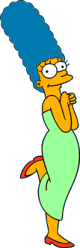



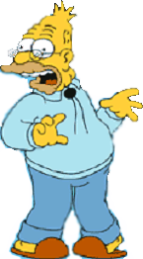
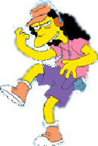






What is a natural grouping among these objects?
Clustering is subjective
Simpson's Family
School Employees
Females
Males

Slide 60
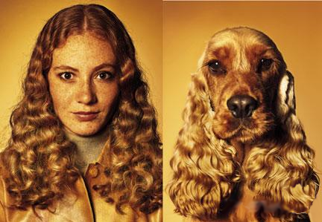
What is Similarity?
The quality or state of being similar; likeness; resemblance; as, a similarity of features.
Webster's Dictionary
Similarity is hard to define, but…
“We know it when we see it”
The real meaning of similarity is a philosophical question. We will take a more pragmatic approach.

Slide 61
How do we define “similarity”?
Recall that the goal is to group together “similar” data – but what does this mean?
No single answer – it depends on what we want to find or emphasize in the data; this is one reason why clustering is an “art”
The similarity measure is often more important than the clustering algorithm used – don’t overlook this choice!

Slide 62
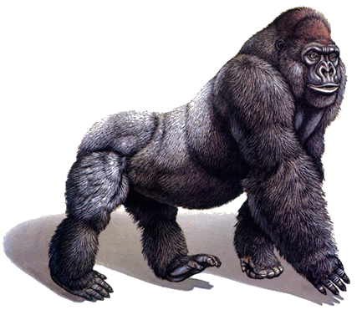
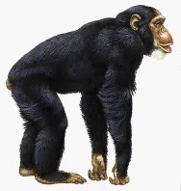
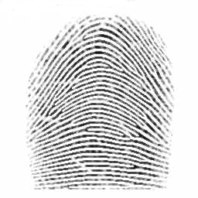
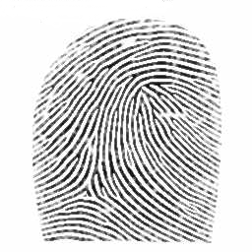
Defining Distance Measures
Definition: Let O₁ and O₂ be two objects from the universe of possible objects. The distance (dissimilarity) between O₁ and O₂ is a real number denoted by D(O₁,O₂)
Peter
Piotr
0.23
3
342.7

Slide 63
Distance Measures Properties:
d(i,j) ≥ 0
d(i,i) = 0
d(i,j) = d(j,i)
d(i,j) ≤ d(i,k) + d(k,j)
Also, one can use weighted distance, parametric Pearson product moment correlation, or other dissimilarity measures.

Slide 64
Intuitions behind desirable distance measure properties
D(A,B) = D(B,A) Symmetry
Otherwise you could claim “Alex looks like Bob, but Bob looks nothing like Alex.”
D(A,A) = 0 Distance to itself
Otherwise you could claim “Alex looks more like Bob, than Bob does.”
D(A,B) >=0 Non-negativity
D(A,B) ≤ D(A,C) + D(B,C) Triangular Inequality
Otherwise you could claim “Alex is very like Bob, and Alex is very like Carl, but Bob is very unlike Carl.”

Slide 65
Similarity and Dissimilarity Between Objects
Distances are normally used to measure the similarity or dissimilarity between two data objects.
Some popular ones include: Minkowski distance:
where i = (x_{i1}, x_{i2}, …, x_{ip}) and j = (x_{j1}, x_{j2}, …, x_{jp}) are two p-dimensional data objects, and q is a positive integer
If q = 1, d is Manhattan distance:
If q = 2, d is Euclidean distance:

Slide 66
Euclidean distance

Slide 67
Manhattan distance
Notes:
Other dissimilarity measures are available

Slide 68
Euclidian and Manhattan Distance
=3-1
=5-2

Slide 69
Considerations for Cluster Analysis
Partitioning criteria
Single level vs. hierarchical partitioning (often, multi-level hierarchical partitioning is desirable)
Separation of clusters
Exclusive (e.g., one customer belongs to only one region) vs. non-exclusive (e.g., one document may belong to more than one class)
Similarity measure
Distance-based (e.g., Euclidian, road network, vector) vs. connectivity-based (e.g., density or contiguity)
Clustering space
Full space (often when low dimensional) vs. subspaces (often in high-dimensional clustering)

Slide 70
Requirements and Challenges
Scalability
Clustering all the data instead of only on samples
Ability to deal with different types of attributes
Numerical, binary, categorical, ordinal, linked, and mixture of these
Constraint-based clustering
User may give inputs on constraints
Use domain knowledge to determine input parameters
Interpretability and usability
Others
Discovery of clusters with arbitrary shape
Ability to deal with noisy data
Incremental clustering and insensitivity to input order
High dimensionality

Slide 71
Major Clustering Approaches (I)
Partitioning approach:
Construct various partitions and then evaluate them by some criterion, e.g., minimizing the sum of square errors
Typical methods: k-means, k-medoids, CLARANS
Hierarchical approach:
Create a hierarchical decomposition of the set of data (or objects) using some criterion
Typical methods: Diana, Agnes, BIRCH, CAMELEON
Density-based approach:
Based on connectivity and density functions
Typical methods: DBSACN, OPTICS, DenClue
Grid-based approach:
based on a multiple-level granularity structure
Typical methods: STING, WaveCluster, CLIQUE

Slide 72
Major Clustering Approaches (II)
Model-based:
A model is hypothesized for each of the clusters and tries to find the best fit of that model to each other
Typical methods: EM, SOM, COBWEB
Frequent pattern-based:
Based on the analysis of frequent patterns
Typical methods: p-Cluster
User-guided or constraint-based:
Clustering by considering user-specified or application-specific constraints
Typical methods: COD (obstacles), constrained clustering
Link-based clustering:
Objects are often linked together in various ways
Massive links can be used to cluster objects: SimRank, LinkClus

Slide 73


Types of Clustering
Partitional algorithms: Construct various partitions and then evaluate them by some criterion
Hierarchical algorithms: Create a hierarchical decomposition of the set of objects using some criterion
Hierarchical
Partitional

Slide 74
Partitioning Algorithms: Basic Concept
Partitioning method: Partitioning a database D of n objects into a set of k clusters, such that the sum of squared distances is minimized (where c_{i} is the centroid or medoid of cluster C_{i})
Given k, find a partition of k clusters that optimizes the chosen partitioning criterion
Global optimal: exhaustively enumerate all partitions
Heuristic methods: k-means and k-medoids algorithms
k-means (MacQueen’67, Lloyd’57/’82): Each cluster is represented by the center of the cluster
k-medoids or PAM (Partition around medoids) (Kaufman & Rousseeuw’87): Each cluster is represented by one of the objects in the cluster

Slide 75
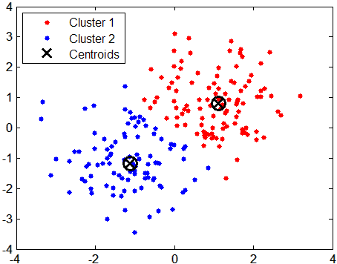
Typical Alternatives Distances between Clusters

Slide 76
מדדים של אשכולות
צנטרואיד - מרכז האשכול – זהו וקטור שמספר הממדים שלו שווה למספר המשתנים, כאשר כל מקום בווקטור שווה לממוצע של המשתנה עבור כל האובייקטים באשכול
מדואיד - הנקודה המרכזית ביותר בתוך האשכול שהיא אובייקט ב-dataset
רדיוס – המרחק הממוצע של כל אובייקט באשכול מהצנטרואיד
קוטר – המרחק הממוצע בין כל שתי נקודות בתוך האשכול.
*הרדיוס והקוטר משקפים את ה"הידוק" של האשכול מסביב לצנטרואיד.

Slide 77
The K-Means Clustering Method
Given k, the k-means algorithm is implemented in four steps:
Partition objects into k nonempty subsets
Compute seed points as the centroids of the clusters of the current partitioning (the centroid is the center, i.e., mean point, of the cluster)
Assign each object to the cluster with the nearest seed point
Go back to Step 2, stop when the assignment does not change

Slide 78
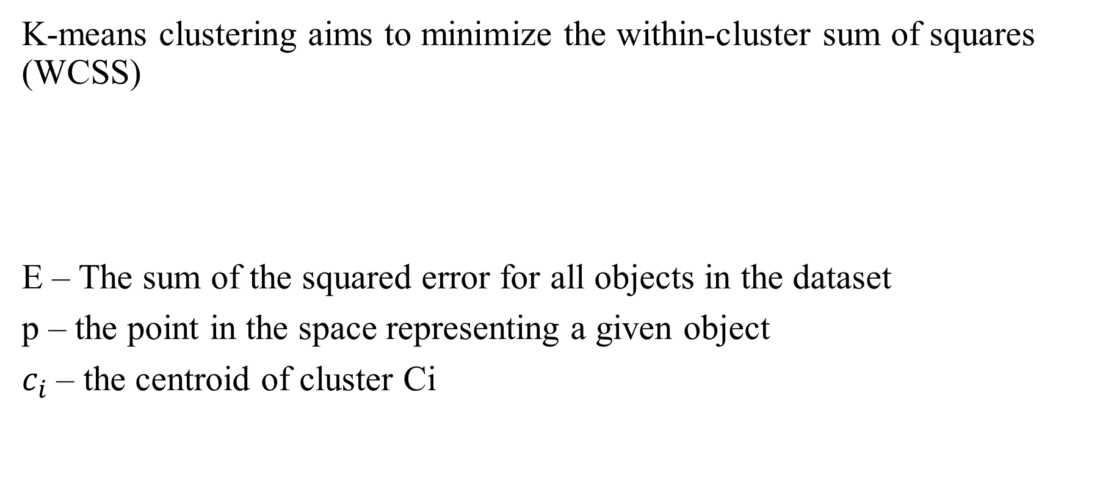
K-means
K-means clustering aims to minimize the within-cluster sum of squares (WCSS)
E – The sum of the squared error for all objects in the dataset
p – the point in the space representing a given object
$c_{i}$ – the centroid of cluster Ci

Slide 79
An Example of K-Means Clustering
K=2
Arbitrarily partition objects into k groups
Update the cluster centroids
The initial data set
Loop if needed
Reassign objects
Partition objects into k nonempty subsets
Repeat
Compute centroid (i.e., mean point) for each partition
Assign each object to the cluster of its nearest centroid
Until no change
Update the cluster centroids

Slide 80
K-means
Choose the number of clusters - k
Cluster initialization:
(a) Randomly generate k clusters and determine the cluster centers
or
(b) Randomly choose k observations from the dataset and use these as the initial cluster centroids.
Until no change, do:
Assign each point to the cluster to which the object is most similar, based on the mean value of the objects in the cluster
Update the cluster means, i.e., calculate the mean value of the objects for each cluster
Sensitive to outliers and noise.

Slide 81
k-means Example
הריצו את אלגוריתם k-means כאשר K=3.

Slide 82
k-means Example
K=3, Iteration #1:

Slide 83
k-means Example
Objects Re-assignment:
= sqrt((0.1-0.52)²+(0.2-0.41)²+(0.15-0.403)²+(0.3-0.513)²+(0.25-0.548)²+(0.23-0.543)²=0.718
Using Euclidean distance

Slide 84
k-means Example
Iteration #2:

Slide 85
k-means Example
Objects Re-assignment:
= sqrt((0.1-0.123)²+(0.2-0.203)²+(0.15-0.143)²+(0.3-0.283)²+(0.25-0.277)²+(0.23-0.250)²=0.045
Convergence!
Using Euclidean distance

Slide 86
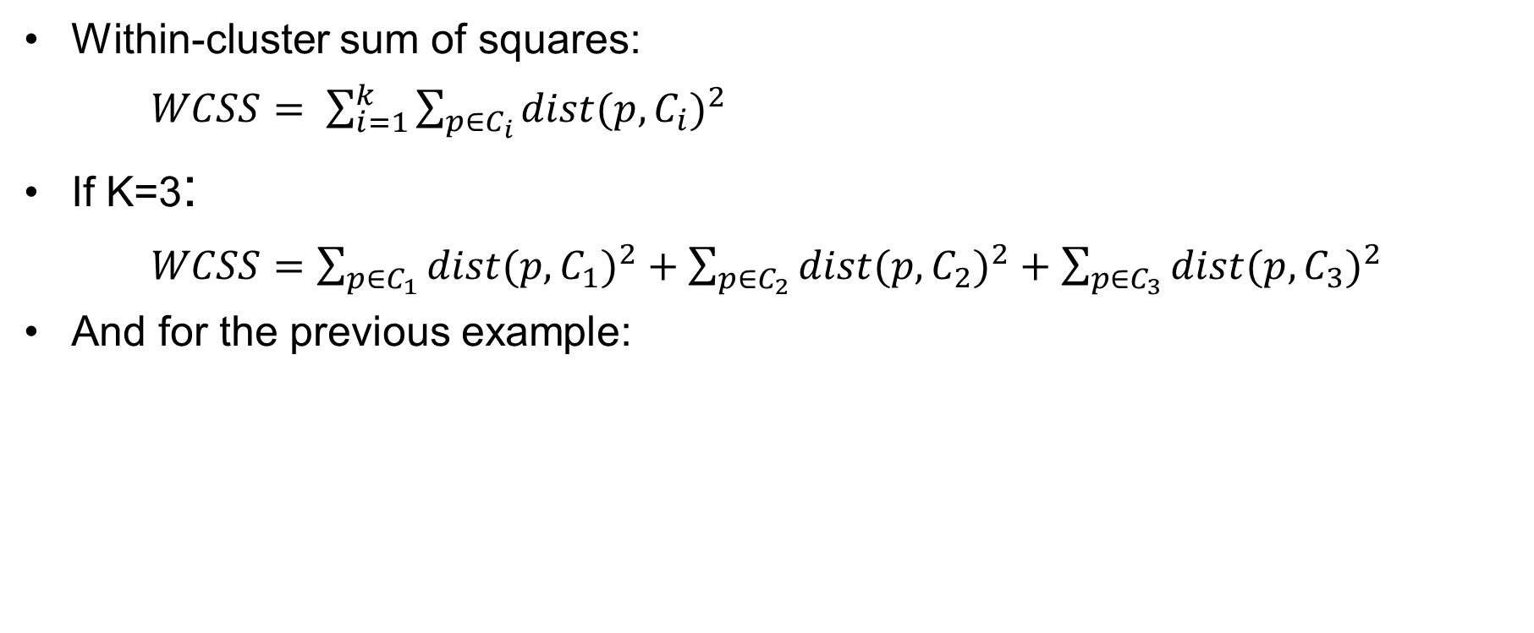
Choosing the Number of Clusters
Obs | cluster | dist | dist²
1 | 1 | 0.045 | 0.002025
3 | 1 | 0.046 | 0.002116
8 | 1 | 0.047 | 0.002209
2 | 2 | 0.06 | 0.0036
4 | 2 | 0.081 | 0.006561
7 | 2 | 0.066 | 0.004356
5 | 3 | 0.07 | 0.0049
6 | 3 | 0.082 | 0.006724
9 | 3 | 0.24 | 0.0576
10 | 3 | 0.115 | 0.013225
 |  | WCSS | 0.103316

Slide 87
Comments on the K-Means Method
Strength: Efficient: O(tkn), where n is # objects, k is # clusters, and t is # iterations. Normally, k, t << n.
Comparing: PAM: O(k(n-k)² ), CLARA: O(ks² + k(n-k))
Comment: Often terminates at a local optimal.
Weakness
Applicable only to objects in a continuous n-dimensional space
Using the k-modes method for categorical data
In comparison, k-medoids can be applied to a wide range of data
Need to specify k, the number of clusters, in advance (there are ways to automatically determine the best k (see Hastie et al., 2009)
Sensitive to noisy data and outliers
Not suitable to discover clusters with non-convex shapes

Slide 88
Variations of the K-Means Method
Most of the variants of the k-means which differ in
Selection of the initial k means
Dissimilarity calculations
Strategies to calculate cluster means
Handling categorical data: k-modes
Replacing means of clusters with modes
Using new dissimilarity measures to deal with categorical objects
Using a frequency-based method to update modes of clusters
A mixture of categorical and numerical data: k-prototype method

Slide 89
What Is the Problem of the K-Means Method?
The k-means algorithm is sensitive to outliers !
Since an object with an extremely large value may substantially distort the distribution of the data
K-Medoids: Instead of taking the mean value of the object in a cluster as a reference point, medoids can be used, which is the most centrally located object in a cluster
10
10
9
9
8
8
7
7
6
6
5
5
4
4
3
3
2
2
1
1
0
0
1
2
3
4
5
6
7
8
9
10
0
0
1
2
3
4
5
6
7
8
9
10

Slide 90
PAM: A Typical K-Medoids Algorithm
Total Cost = 20
10
9
8
Arbitrary choose k object as initial medoids
Assign each remaining object to nearest medoids
7
6
5
4
3
2
1
0
0
1
2
3
4
5
6
7
8
9
10
K=2
Randomly select a nonmedoid object,O_{ramdom}
Total Cost = 26
Do loop
Until no change
10
10
9
Compute total cost of swapping
9
Swapping O and O_{ramdom}
If quality is improved.
8
8
7
7
6
6
5
5
4
4
3
3
2
2
1
1
0
0
1
2
3
4
5
6
7
8
9
10
0
0
1
2
3
4
5
6
7
8
9
10
90
Notes:
90

Slide 91
The K-Medoid Clustering Method
K-Medoids Clustering: Find representative objects (medoids) in clusters
PAM (Partitioning Around Medoids, Kaufmann & Rousseeuw 1987)
Starts from an initial set of medoids and iteratively replaces one of the medoids by one of the non-medoids if it improves the total distance of the resulting clustering
PAM works effectively for small data sets, but does not scale well for large data sets (due to the computational complexity)
Efficiency improvement on PAM
CLARA (Kaufmann & Rousseeuw, 1990): PAM on samples
CLARANS (Ng & Han, 1994): Randomized re-sampling

Slide 92
K – Medoids Clustering

Slide 93
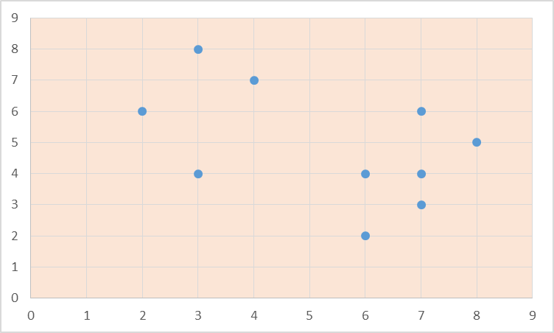
PAM Example
o₁ = x6 o₂ = x8
חישבו K-medoid לרשומות הבאות כאשר האובייקט הראשון שנבחר הוא 6X ואילו השני 8X.
x1 | 2 | 6
x2 | 3 | 4
x3 | 3 | 8
x4 | 4 | 7
x5 | 6 | 2
x6 | 6 | 4
x7 | 7 | 3
x8 | 7 | 4
x9 | 8 | 5
x10 | 7 | 6

Slide 94
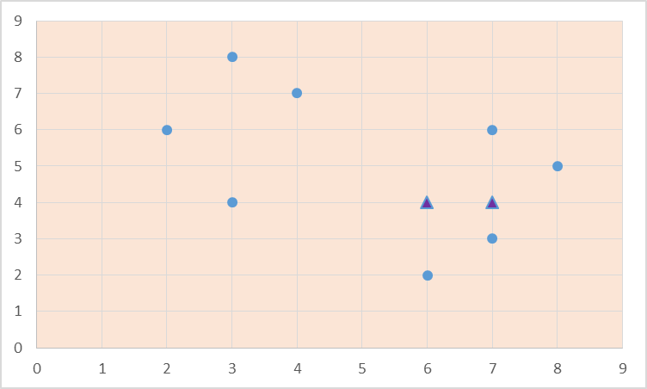
Dist(x1, c1) = |2-6|+|4-6|=6
 |  |  |  | dist to o₁ | dist to o₂ | cluster
x1 | 2 | 6 |  | 6 | 7 | 1
x2 | 3 | 4 |  | 3 | 4 | 1
x3 | 3 | 8 |  | 7 | 8 | 1
x4 | 4 | 7 |  | 5 | 6 | 1
x5 | 6 | 2 |  | 2 | 3 | 1
x6 | 6 | 4 | o₁ | 0 | 1 | 1
x7 | 7 | 3 |  | 2 | 1 | 2
x8 | 7 | 4 | o₂ | 1 | 0 | 2
x9 | 8 | 5 |  | 3 | 2 | 2
x10 | 7 | 6 |  | 3 | 2 | 2
 |  |  | cost | 23 | 5
Dist(x1, c1) = |7-7|+|6-4|=2
Total cost = 6+3+7+5+2+0 + 1+0+2+2 = 28
Cluster 1
Cluster 2
o₂ = x8, O_{random}=x4

Slide 95
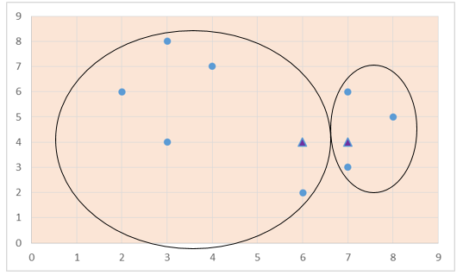
PAM Example
o₁ = x4 o₂ = x8
חישבו K-medoid לרשומות הבאות כאשר האובייקט הראשון שנבחר הוא 6X ואילו השני 8X.
x1 | 2 | 6
x2 | 3 | 4
x3 | 3 | 8
x4 | 4 | 7
x5 | 6 | 2
x6 | 6 | 4
x7 | 7 | 3
x8 | 7 | 4
x9 | 8 | 5
x10 | 7 | 6

Slide 96
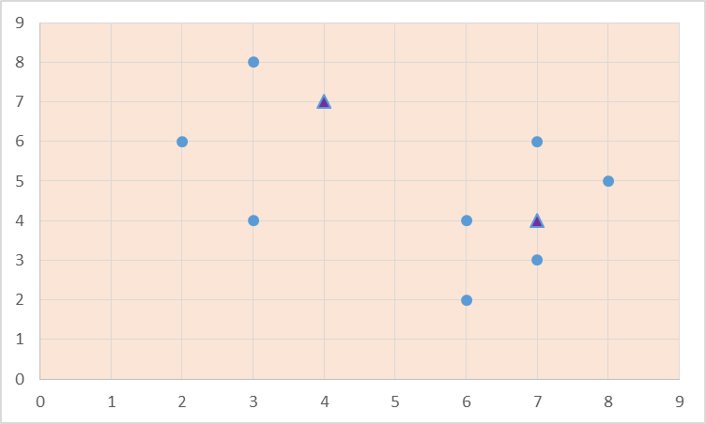
 |  |  |  | dis to o₁ | dis to o₂ | old cluster | new cluster
x1 | 2 | 6 |  | 3 | 7 | 1 | 1
x2 | 3 | 4 |  | 4 | 4 | 1 | 1
x3 | 3 | 8 |  | 2 | 8 | 1 | 1
x4 | 4 | 7 | O_{random} | 0 | 6 | 1 | 1
x5 | 6 | 2 |  | 7 | 3 | 1 | 2
x6 | 6 | 4 |  | 5 | 1 | 1 | 2
x7 | 7 | 3 |  | 7 | 1 | 2 | 2
x8 | 7 | 4 | o₂ | 6 | 0 | 2 | 2
x9 | 8 | 5 |  | 6 | 2 | 2 | 2
x10 | 7 | 6 |  | 4 | 2 | 2 | 2
 |  |  | cost | 9 | 9
Total cost = 3+4+2+0 + 3+1+1+0+2+2 =18
Cluster 1
Cluster 2
S = new cost – old cost = 18-28 = -10
S<0 swap!

Slide 97
What Is the Problem with PAM?
Pam is more robust than k-means in the presence of noise and outliers because a medoid is less influenced by outliers or other extreme values than a mean
Pam works efficiently for small data sets but does not scale well for large data sets.
O(k(n-k)² ) for each iteration
where n is # of data,k is # of clusters
Sampling-based method
CLARA(Clustering LARge Applications)

Slide 98
Hierarchical Clustering
Use distance matrix as clustering criteria. This method does not require the number of clusters k as an input, but needs a termination condition
Step 0
Step 1
Step 2
Step 3
Step 4
agglomerative
(AGNES)
a
a b
b
a b c d e
c
c d e
d
d e
e
divisive
(DIANA)
Step 4
Step 3
Step 2
Step 1
Step 0

Slide 99
Hierarchical clustering
Hierarchical clustering is a method of cluster analysis which seeks to build a hierarchy of clusters. Strategies for hierarchical clustering generally fall into two types:
Agglomerative (AGNES): This is a "bottom up" approach: each observation starts in its own cluster, and pairs of clusters are merged as one moves up the hierarchy.
Divisive (DIANA): This is a "top down" approach: all observations start in one cluster, and splits are performed recursively as one moves down the hierarchy.
The results of hierarchical clustering are usually presented in a dendrogram.

Slide 100
Linkage criteria
Any valid metric may be used as a measure of similarity between pairs of clusters.
The choice of which clusters to merge or split is determined by a linkage criteria, which is a function of the pairwise distances between clusters.
Some commonly used linkage criteria between two clusters A and B are:
Maximum or complete linkage clustering - the longest distance from any member of A to any member of B.
Minimum or single-linkage clustering - the shortest distance from any member of A to any member of B.
Mean or average linkage clustering - the average distance from any member of A to any member of B.

Slide 101
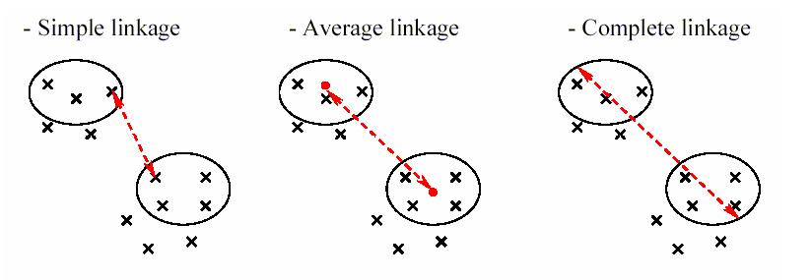
Linkage criteria

Slide 102
AGNES (Agglomerative Nesting)
Introduced in Kaufmann and Rousseeuw (1990)
Implemented in statistical packages, e.g., Splus
Use the single-link method and the dissimilarity matrix
Merge nodes that have the least dissimilarity
Go on in a non-descending fashion
Eventually all nodes belong to the same cluster

Slide 103
Dendrogram: Shows How Clusters are Merged
Decompose data objects into a several levels of nested partitioning (tree of clusters), called a dendrogram
A clustering of the data objects is obtained by cutting the dendrogram at the desired level, then each connected component forms a cluster

Slide 104
Algorithm (Agglomerative)
Start by assigning each item to its own cluster (N items result in N clusters). Let the distances/similarities between the clusters equal the distances/similarities between the items they contain.
Find the closest (most similar) pair of clusters and merge them into a single cluster, so that now you have one less cluster.
Compute distances (similarities) between the new cluster and each of the old clusters.
Repeat steps 2 and 3 until all items are clustered into a single cluster of size N.
single-link or complete-link or average-link clustering?

Slide 105
Example
The following slides trace a hierarchical clustering of distances in miles between U.S. cities. The method of clustering is single-link.
 | BOS | NY | DC | MIA | CHI | SEA | SF | LA | DEN
BOS
NY | 206
DC | 429 | 233
MIA | 1504 | 1308 | 1075
CHI | 963 | 802 | 671 | 1329
SEA | 2976 | 2815 | 2684 | 3273 | 2013
SF | 3095 | 2934 | 2799 | 3053 | 2142 | 808
LA | 2979 | 2786 | 2631 | 2687 | 2054 | 1131 | 379
DEN | 1949 | 1771 | 1616 | 2037 | 996 | 1307 | 1235 | 1059

Slide 106
Dendrogram
Distance
1075
1059
996
808
671
379
223
206
MIA
SEA
SF
LA
BOS
NY
DC
CHI
DEN

Slide 107
The nearest pair of cities is BOS and NY, at distance 206. These are merged into a single cluster called "BOS/NY".
Then we compute the distance from this new cluster to all other objects according to single link clustering.
After merging BOS with NY:
d("BOS/NY" , DC) = 233 = d(NY, DC).
 | BOS/NY | DC | MIA | CHI | SEA | SF | LA | DEN
BOS/NY
DC | 233
MIA | 1308 | 1075
CHI | 802 | 671 | 1329
SEA | 2815 | 2684 | 3273 | 2013
SF | 2934 | 2799 | 3053 | 2142 | 808
LA | 2786 | 2631 | 2687 | 2054 | 1131 | 379
DEN | 1771 | 1616 | 2037 | 996 | 1307 | 1235 | 1059
d("BOS/NY" , DEN) = 1771

Slide 108
Distance
1075
1059
996
808
671
379
223
206
MIA
SEA
SF
LA
BOS
NY
DC
CHI
DEN

Slide 109
The nearest pair of objects is BOS/NY and DC, at distance 223. These are merged into a single cluster called "BOS/NY/DC". Then we compute the distance from this new cluster to all other clusters, to get a new distance matrix:
After merging DC with BOS-NY:
 | BOS/NY/DC | MIA | CHI | SEA | SF | LA | DEN
BOS/NY/DC
MIA | 1075
CHI | 671 | 1329
SEA | 2684 | 3273 | 2013
SF | 2799 | 3053 | 2142 | 808
LA | 2631 | 2687 | 2054 | 1131 | 379
DEN | 1616 | 2037 | 996 | 1307 | 1235 | 1059

Slide 110
Distance
1075
1059
996
808
671
379
223
206
MIA
SEA
SF
LA
BOS
NY
DC
CHI
DEN

Slide 111
Now, the nearest pair of objects is SF and LA, at distance 379. These are merged into a single cluster called "SF/LA". Then we compute the distance from this new cluster to all other objects, to get a new distance matrix:
After merging SF with LA:
 | BOS/NY/DC | MIA | CHI | SEA | SF/LA | DEN
BOS/NY/DC
MIA | 1075
CHI | 671 | 1329
SEA | 2684 | 3273 | 2013
SF/LA | 2631 | 2687 | 2054 | 808
DEN | 1616 | 2037 | 996 | 1307 | 1059

Slide 112
Distance
1075
1059
996
808
671
379
223
206
MIA
SEA
SF
LA
BOS
NY
DC
CHI
DEN

Slide 113
Now, the nearest pair of objects is CHI and BOS/NY/DC, at distance 671. These are merged into a single cluster called "BOS/NY/DC/CHI". Then we compute the distance from this new cluster to all other clusters, to get a new distance matrix:
After merging CHI with BOS/NY/DC:
 | BOS/NY/DC/CHI | MIA | SEA | SF/LA | DEN
BOS/NY/DC/CHI
MIA | 1075
SEA | 2013 | 3273
SF/LA | 2054 | 2687 | 808
DEN | 996 | 2037 | 1307 | 1059

Slide 114
Distance
1075
1059
996
808
671
379
223
206
MIA
SEA
SF
LA
BOS
NY
DC
CHI
DEN

Slide 115
Now, the nearest pair of objects is SEA and SF/LA, at distance 808. These are merged into a single cluster called "SF/LA/SEA". Then we compute the distance from this new cluster to all other clusters, to get a new distance matrix:
After merging SEA with SF/LA:
 | BOS/NY/DC/CHI | MIA | SF/LA/SEA | DEN
BOS/NY/DC/CHI
MIA | 1075
SF/LA/SEA | 2054 | 2687
DEN | 996 | 2037 | 1059

Slide 116
Distance
1075
1059
996
808
671
379
223
206
MIA
SEA
SF
LA
BOS
NY
DC
CHI
DEN

Slide 117
Now, the nearest pair of objects is DEN and BOS/NY/DC/CHI, at distance 996. These are merged into a single cluster called "BOS/NY/DC/CHI/DEN". Then we compute the distance from this new cluster to all other clusters, to get a new distance matrix:
After merging DEN with BOS/NY/DC/CHI:
 | BOS/NY/DC/CHI/DEN | MIA | SF/LA/SEA
BOS/NY/DC/CHI/DEN
MIA | 1075
SF/LA/SEA | 1059 | 2687

Slide 118
Distance
1075
1059
996
808
671
379
223
206
MIA
SEA
SF
LA
BOS
NY
DC
CHI
DEN

Slide 119
Now, the nearest pair of objects is BOS/NY/DC/CHI/DEN and SF/LA/SEA, at distance 1059. These are merged into a single cluster called "BOS/NY/DC/CHI/DEN/SF/LA/SEA". Then we compute the distance from this new compound object to all other objects, to get a new distance matrix:
After merging SF/LA/SEA with BOS/NY/DC/CHI/DEN:
 | BOS/NY/DC/CHI/DEN/SF/LA/SEA | MIA
BOS/NY/DC/CHI/DEN/SF/LA/SEA
MIA | 1075

Slide 120
Distance
1075
1059
996
808
671
379
223
206
MIA
SEA
SF
LA
BOS
NY
DC
CHI
DEN

Slide 121
AGNES (Agglomerative Nesting)
Introduced in Kaufmann and Rousseeuw (1990)
Implemented in statistical packages, e.g., Splus
Use the single-link method and the dissimilarity matrix
Merge nodes that have the least dissimilarity
Go on in a non-descending fashion
Eventually all nodes belong to the same cluster

Slide 122
DIANA (Divisive Analysis)
Introduced in Kaufmann and Rousseeuw (1990)
Implemented in statistical analysis packages, e.g., Splus
Inverse order of AGNES
Eventually each node forms a cluster on its own

Slide 123
Distance between Clusters
X
X
Single link: smallest distance between an element in one cluster and an element in the other, i.e., dist(K_{i}, K_{j}) = min(t_{ip}, t_{jq})
Complete link: largest distance between an element in one cluster and an element in the other, i.e., dist(K_{i}, K_{j}) = max(t_{ip}, t_{jq})
Average: avg distance between an element in one cluster and an element in the other, i.e., dist(K_{i}, K_{j}) = avg(t_{ip}, t_{jq})
Centroid: distance between the centroids of two clusters, i.e., dist(K_{i}, K_{j}) = dist(C_{i}, C_{j})
Medoid: distance between the medoids of two clusters, i.e., dist(K_{i}, K_{j}) = dist(M_{i}, M_{j})
Medoid: a chosen, centrally located object in the cluster
123
Notes:
123

Slide 124
Centroid, Radius and Diameter of a Cluster (for numerical data sets)
Centroid: the “middle” of a cluster
Radius: square root of average distance from any point of the cluster to its centroid
Diameter: square root of average mean squared distance between all pairs of points in the cluster
124
Notes:
124

Slide 125
Extensions to Hierarchical Clustering
Major weakness of agglomerative clustering methods
Can never undo what was done previously
Do not scale well: time complexity of at least O(n²), where n is the number of total objects
Integration of hierarchical & distance-based clustering
BIRCH (1996): uses CF-tree and incrementally adjusts the quality of sub-clusters
CHAMELEON (1999): hierarchical clustering using dynamic modeling

Slide 126
Density-Based Clustering Methods
Clustering based on density (local cluster criterion), such as density-connected points
Major features:
Discover clusters of arbitrary shape
Handle noise
One scan
Need density parameters as termination condition
Several interesting studies:
DBSCAN: Ester, et al. (KDD’96)
OPTICS: Ankerst, et al (SIGMOD’99).
DENCLUE: Hinneburg & D. Keim (KDD’98)
CLIQUE: Agrawal, et al. (SIGMOD’98) (more grid-based)

Slide 127
Density-Based Clustering: Basic Concepts
Two parameters:
Eps: Maximum radius of the neighbourhood
MinPts: Minimum number of points in an Eps-neighbourhood of that point
N_{Eps}(p): {q belongs to D | dist(p,q) ≤ Eps}
Directly density-reachable: A point p is directly density-reachable from a point q w.r.t. Eps, MinPts if
p belongs to N_{Eps}(q)
core point condition:
|N_{Eps} (q)| ≥ MinPts
p
MinPts = 5
Eps = 1 cm
q

Slide 128
Density-Reachable and Density-Connected
Density-reachable:
A point p is density-reachable from a point q w.r.t. Eps, MinPts if there is a chain of points p₁, …, p_{n}, p₁ = q, p_{n} = p such that p_{i+1} is directly density-reachable from p_{i}
Density-connected
A point p is density-connected to a point q w.r.t. Eps, MinPts if there is a point o such that both, p and q are density-reachable from o w.r.t. Eps and MinPts
p
p₁
q
p
q
o

Slide 129
DBSCAN: Density-Based Spatial Clustering of Applications with Noise
Relies on a density-based notion of cluster: A cluster is defined as a maximal set of density-connected points
Discovers clusters of arbitrary shape in spatial databases with noise
Outlier
Border
Eps = 1cm
MinPts = 5
Core

Slide 130
DBSCAN: The Algorithm
Arbitrary select a point p
Retrieve all points density-reachable from p w.r.t. Eps and MinPts
If p is a core point, a cluster is formed
If p is a border point, no points are density-reachable from p and DBSCAN visits the next point of the database
Continue the process until all of the points have been processed

Slide 131
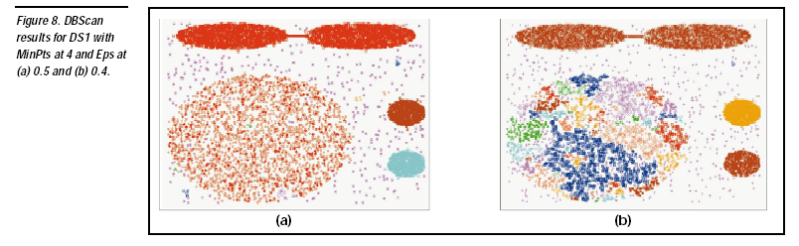
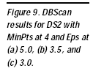
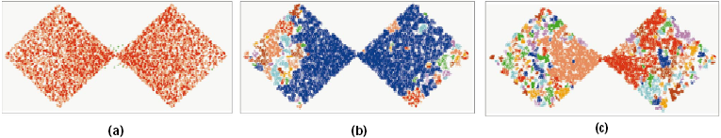
DBSCAN: Sensitive to Parameters

Slide 132
Determine the Number of Clusters
Empirical method
# of clusters ≈√n/2 for a dataset of n points
Elbow method
Use the turning point in the curve of sum of within cluster variance w.r.t the # of clusters
Cross validation method
Divide a given data set into m parts
Use m – 1 parts to obtain a clustering model
Use the remaining part to test the quality of the clustering
E.g., For each point in the test set, find the closest centroid, and use the sum of squared distance between all points in the test set and the closest centroids to measure how well the model fits the test set
For any k > 0, repeat it m times, compare the overall quality measure w.r.t. different k’s, and find # of clusters that fits the data the best
132

Slide 133
Measuring Clustering Quality
Two methods: extrinsic vs. intrinsic
Extrinsic: supervised, i.e., the ground truth is available
Compare a clustering against the ground truth using certain clustering quality measure
Ex. BCubed precision and recall metrics
Intrinsic: unsupervised, i.e., the ground truth is unavailable
Evaluate the goodness of a clustering by considering how well the clusters are separated, and how compact the clusters are
Ex. Silhouette coefficient
133

Slide 134
Measuring Clustering Quality: Extrinsic Methods
134
Clustering quality measure: Q(C, C_{g}), for a clustering C given the ground truth C_{g}.
Q is good if it satisfies the following 4 essential criteria
Cluster homogeneity: the purer, the better
Cluster completeness: should assign objects belong to the same category in the ground truth to the same cluster
Rag bag: putting a heterogeneous object into a pure cluster should be penalized more than putting it into a rag bag (i.e., “miscellaneous” or “other” category)
Small cluster preservation: splitting a small category into pieces is more harmful than splitting a large category into pieces

Slide 135
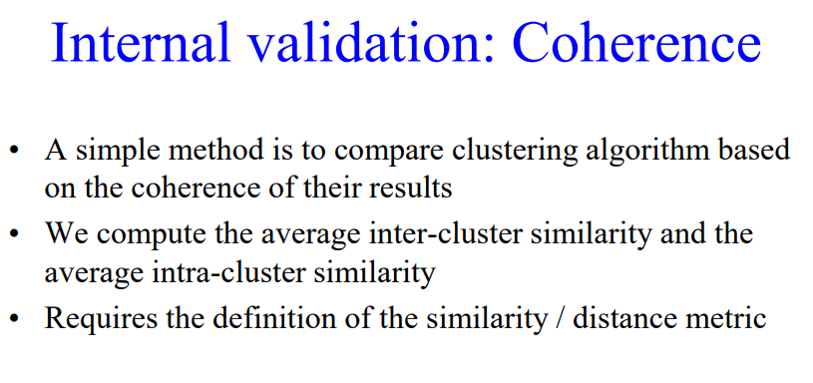
Measuring Clustering Quality
135

